Slide 1

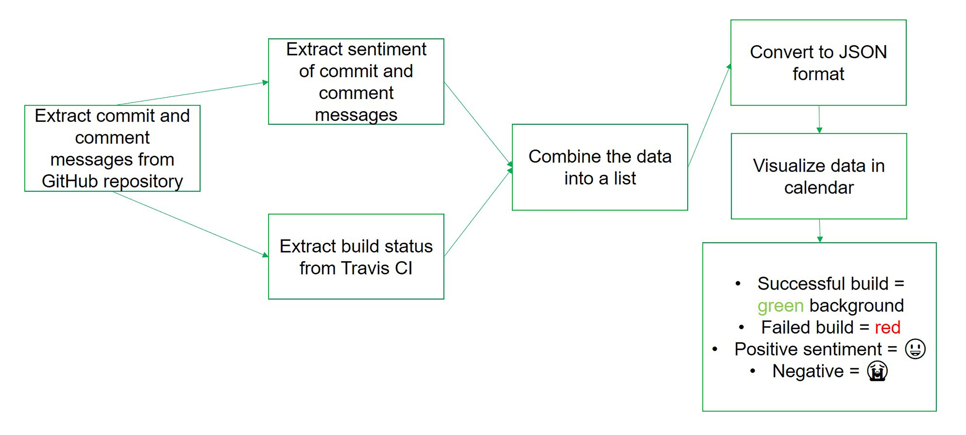


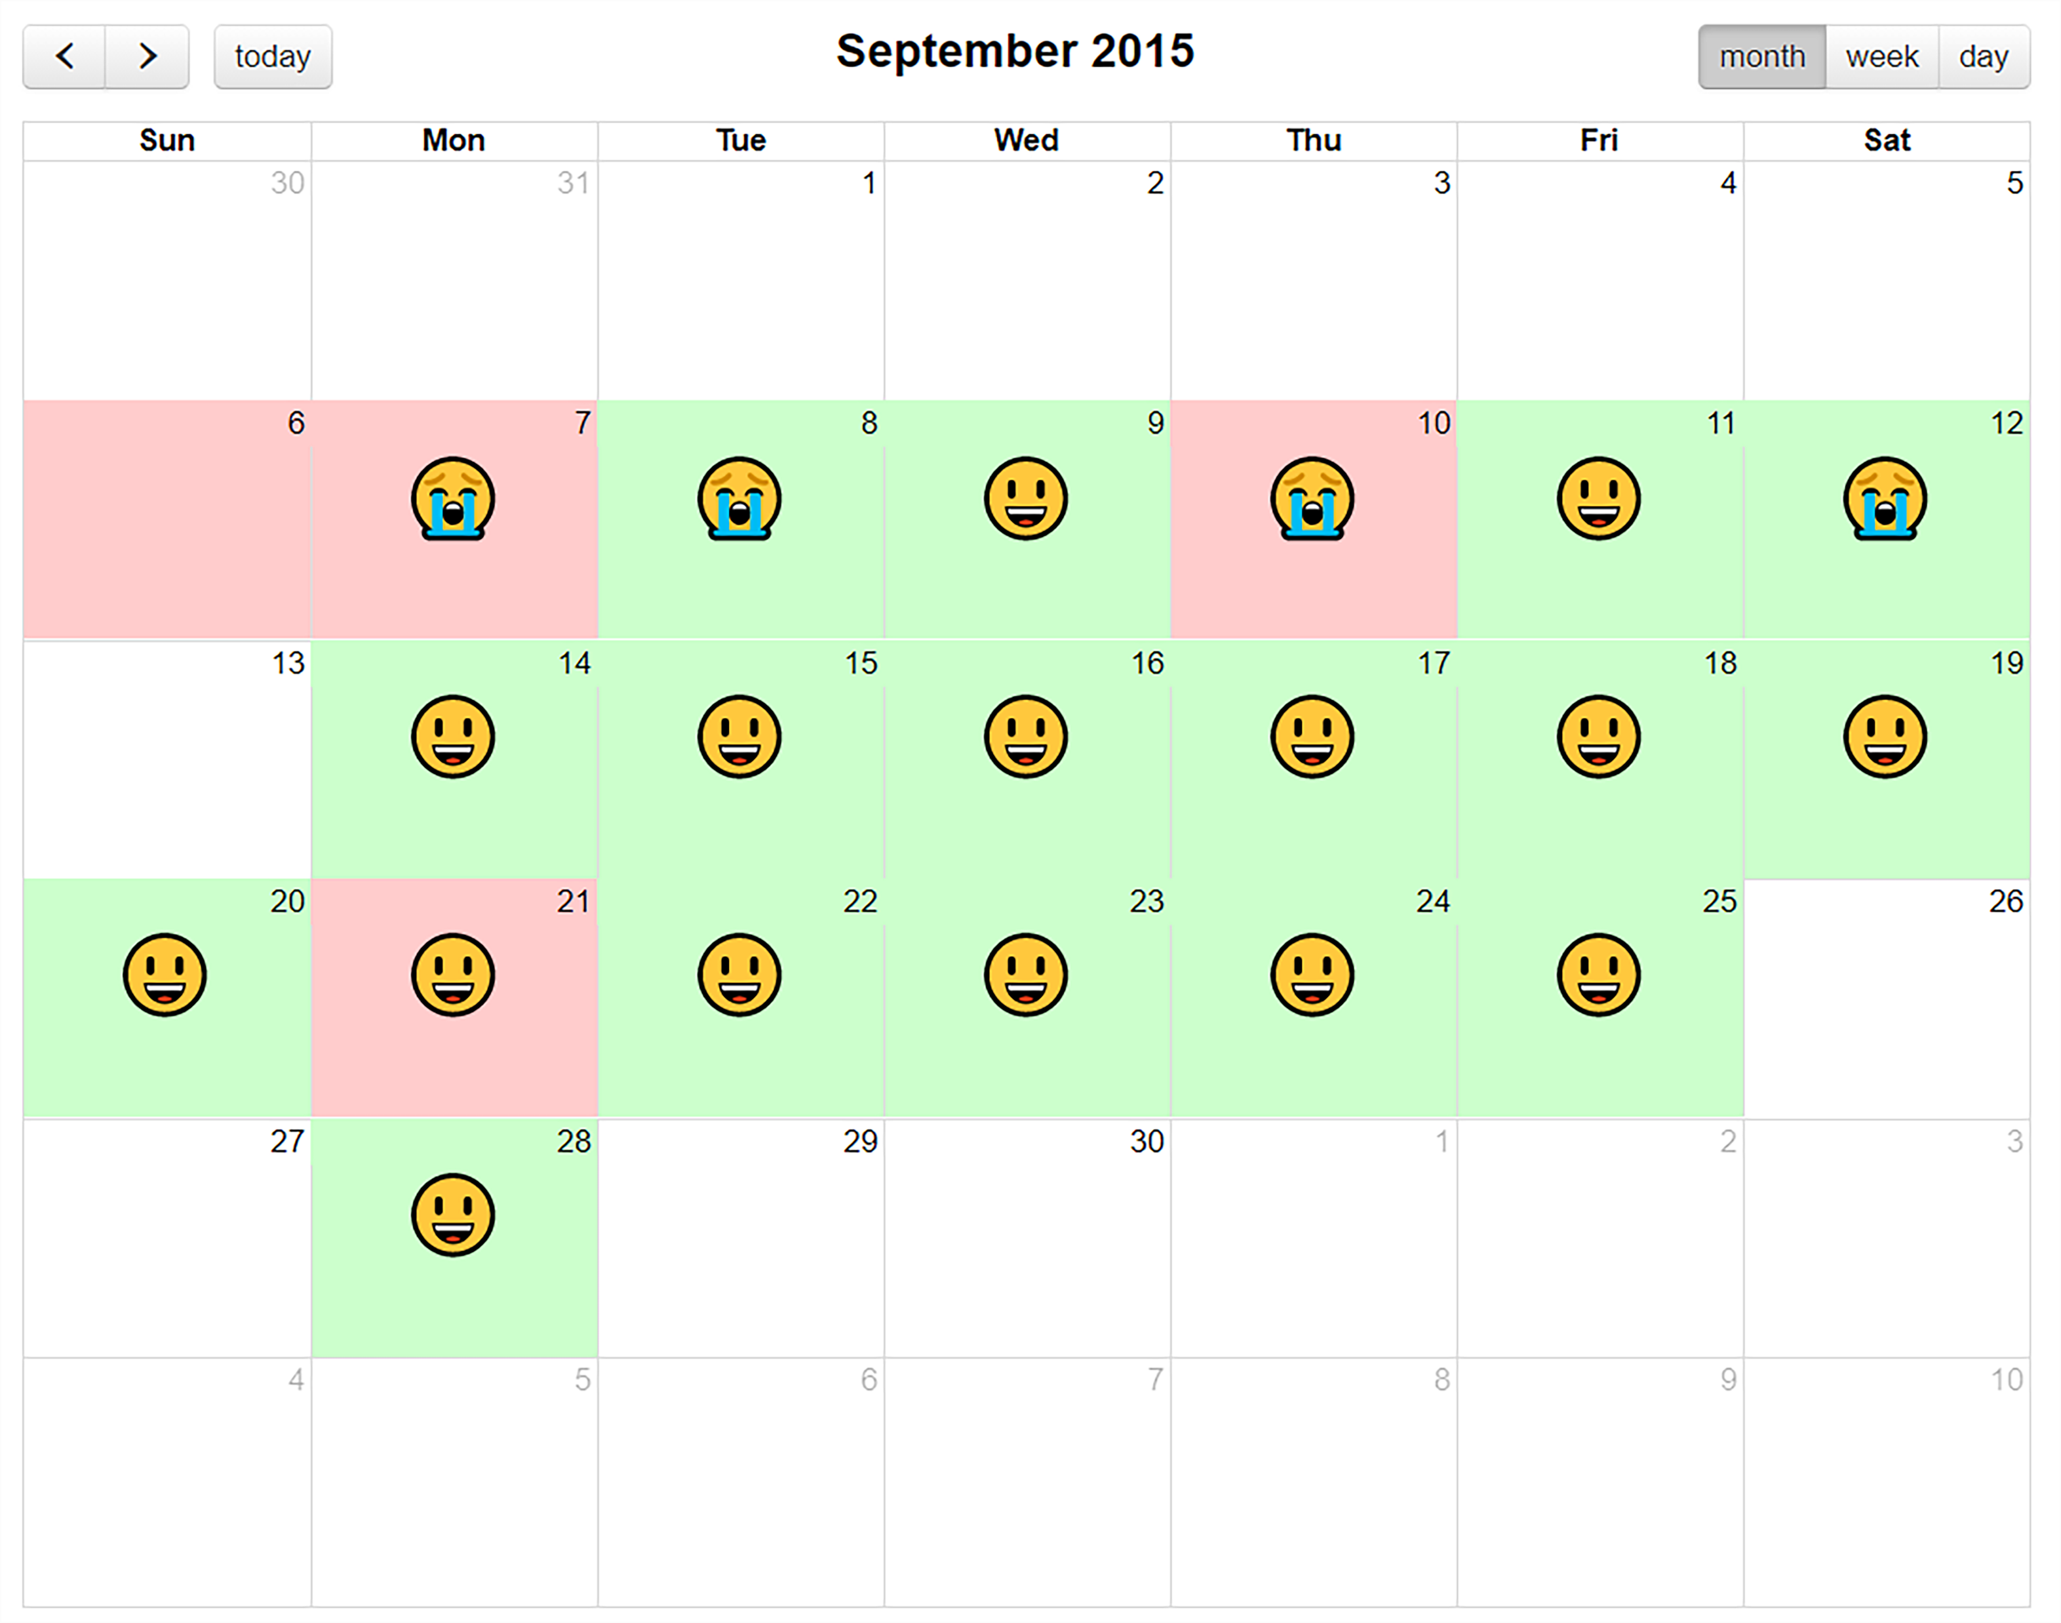
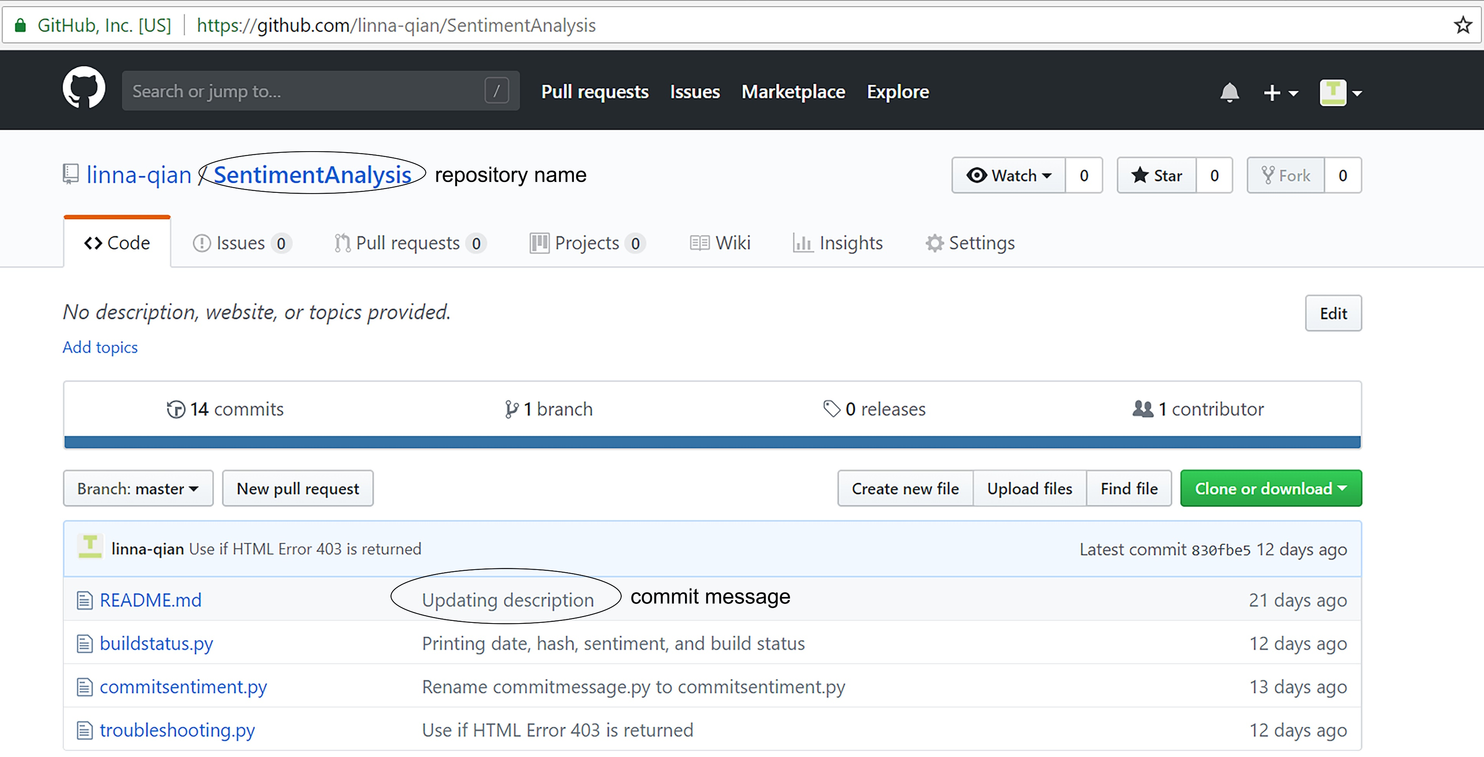
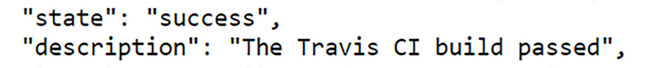
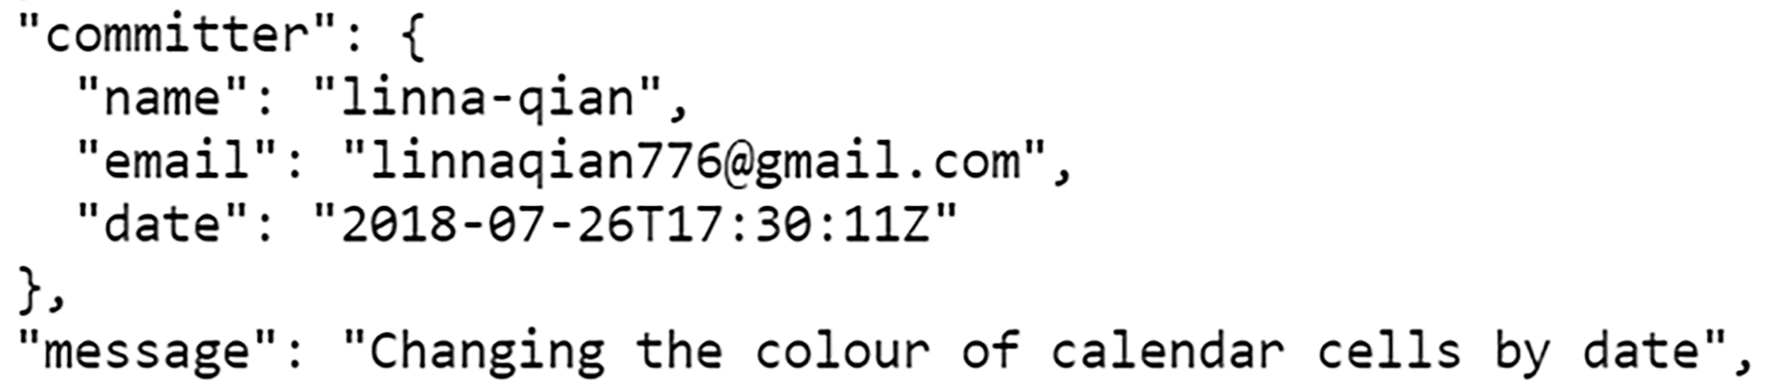
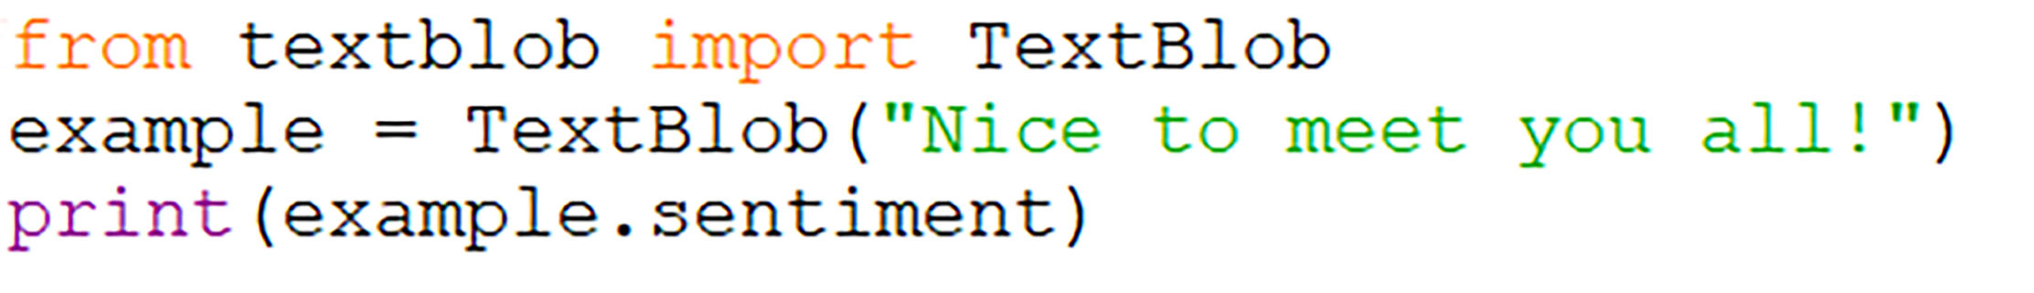
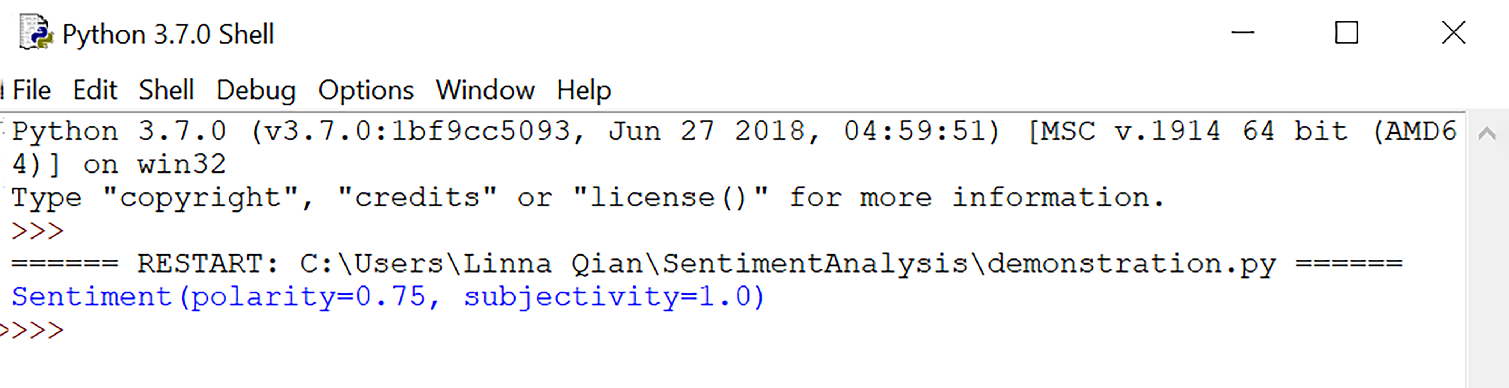
Sentiment Analysis in Program Development
Linna Qian (linna@ualberta.ca) with Moein Owhadi-Kareshk and Dr. Sarah Nadi
Department of Computing Science, University of Alberta
Introduction
Definitions and Examples
Methodology Overview
The software development process is directed by humans and is subsequently affected by its human workers
Angry or sad workers may affect the progress of a company’s project
Difficult for big companies to gauge how employees may feel
GitHub
A website where programmers can store their projects for others to see, use, and develop
Travis CI
A continuous integration platform that automatically builds and tests code changes
Project Objectives
A GitHub repository is where the contents of a project are stored (project file)
Commit messages are messages that programmers attach to the work they upload to their repository
Use sentiment analysis to extract the sentiment of developers’ commit messages and comments, and compare it to the success of the build
Create a visual representation, in the form of a calendar, from the data extracted
Continuous Integration
Merging smaller code changes more frequently rather than one big merge at the end
Result
Future Studies For Sentiment Analysis
Sentiment Analysis
Travis CI Builds
The GitHub repository will be copied and tested in a virtual environment. If any part of the build fails, the build status returned will be either errored or failed¹
Computational process of determining whether the opinion expressed in a piece of text is positive, negative, or neutral¹
Used to determine how people feel about a certain topic
Plays an important role in social media and other business initiatives
Used to improve customer service and relations
¹Oxford English Dictionary
Improving the accuracy of sentiment analysis software (like TextBlob)
Analyzing, not only text, but pictures and videos
Increasing the complexity of text able to be analyzed (eg. correctly interpreting sarcasm and hyperboles)¹
JSON (JavaScript Object Notation)
JSON is a formatting used in data transfer between remote servers and web applications
Extract the sentiment of the commit messages with a Python library called TextBlob. The sentiment is returned as a value between -1 and +1
This is the model calendar for the GitHub repository pingcap/tidb during September 2015. This was one of 15 repositories analyzed.
¹“Future of Sentiment Analysis and Problems Faced.” DatascienceCMU, 19 Apr. 2014, datasciencecmu.wordpress.com/2014/04/18/future-of-sentiment-analysis-and-problems-faced/.
¹“Core Concepts for Beginners.” Travis CI Docs, Travis CI, docs.travis-ci.com/user/for-beginners.
Future Work
Acknowledgements
Figure 2. Example of the output from a Travis CI build.
Preprocess the commit messages to remove text like URLs and code snippets
Adjust sentiment values based on the type of text being analyzed (commit and comment messages for this project)
I would like to thank Dr. Sarah Nadi and Moein Owhadi-Kareshk for welcoming me into the SMR lab and giving me the opportunity to learn about sentiment analysis and program development.
I would also like to thank the Ross and Verna Tate foundation for providing me this opportunity through the High School Internship Program (HIP).
Figure 3. Example of a JSON file.
Figure 4. TextBlob input
Figure 1. Example of a GitHub repository.
Figure 5. TextBlob output

